Slide 1

Library Management System
By
Harikrishna Gonuguntla

Slide 2
Introduction
Library Management System is an application that helps a librarian manage books in a library. It provides basic features for the librarian like adding/updating the books and members of a library. It becomes easy for the librarian to track due dates and send follow-up emails with a single click to members whose due dates are near or whose borrow is overdue. It allows the librarian to check the availability of a book through the search feature. While issuing a book to a member, the system automatically checks the borrow limit of the member. While taking a return, the system, the system automatically checks if the return is overdue, and applies an overdue fee according to the number of days it is past the due date. The librarian is provided an option to waive the overdue fee if a reasonable explanation is provided by the member.

Slide 3
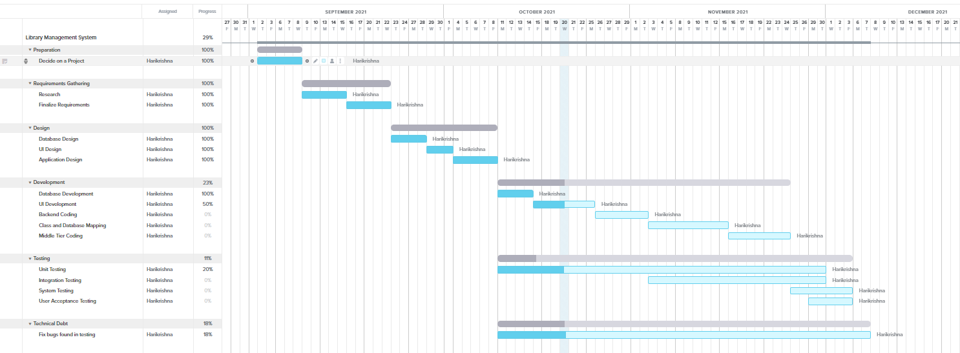
Project Tracking
https://prod.teamgantt.com/gantt/schedule/?ids=2843038#&ids=2843038&user=&custom=&company=&hide_completed=false&date_filter=&color_filter=

Slide 4
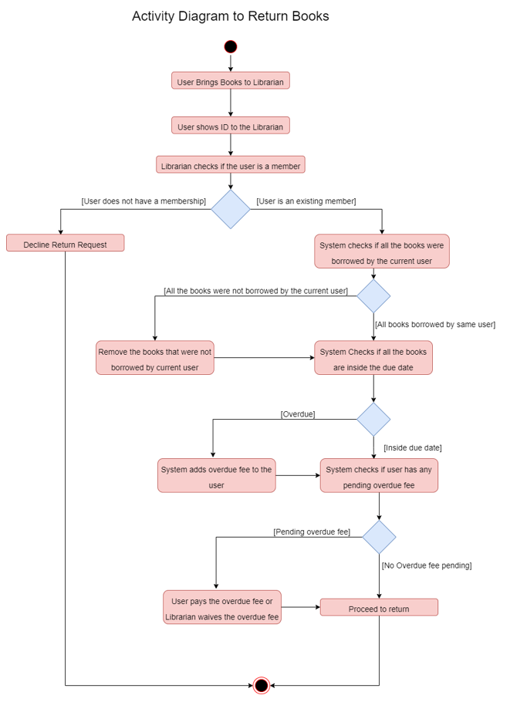
Activity Diagram

Slide 5
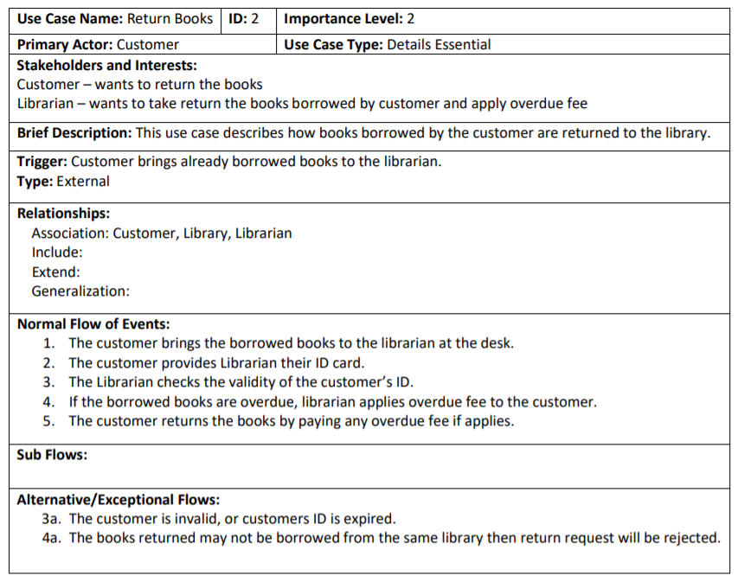
Use-case Description

Slide 6
Implementation Details
Front-End: WPF, XAML
Back-End, Middle: C#
Database Server: SQL Server
DB Management Tool: SSMS(SQL Server Management Studio)
IDE: Visual Studio 2019
Source Control: GitHub
Design Architecture: MVVM

Slide 7
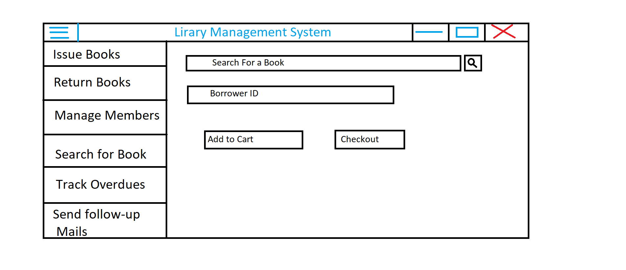
Mock UI

Slide 8
Questions?

